Slide 1
The purpose of LITERATURE

Slide 2
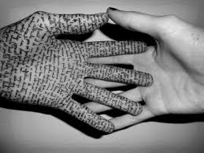
Purpose of Analyzing Literature?
Analyzing literature helps us to better understand what it means to be human (and how to be a better human). It helps us to know how to exist in this world—and how we want to exist in this world.
In my opinion a “good” work of literature is any work that helps us to see and understand other points of view, experiences, philosophies, places, etc., which allows us to have greater empathy for the human condition…
…or in other words, it’s any text that helps us to better understand ourselves, other people and our own ideas about the world.

Slide 3
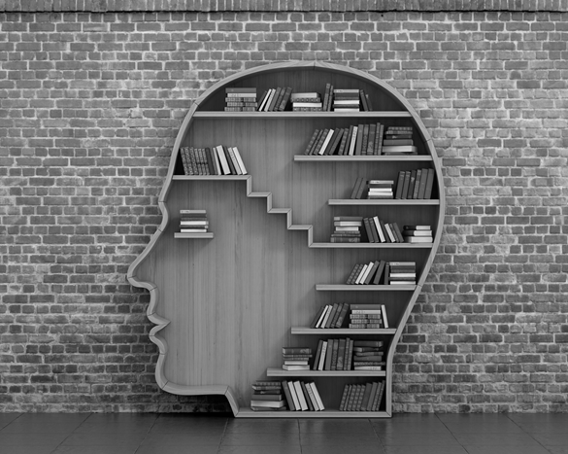
*Regarding the General Purpose of Literary Analysis…
When analyzing literature, you should always ask yourself 3 basic questions:
1.) What is the author’s intended purpose in writing this text?
2.) How do I know this—IOW—what literary clues (craft choices) lead me to my conclusions?
3.) Do I agree with the philosophical ideas that are present in this text? OR—how can this fit into/expand upon my worldview?
*This is what I am here for—to help you better answer the first two questions! The last one is all up to you.

Slide 4
11CCP FOCUS
PURPOSE: We are always looking for ways to better interpret an author’s purpose.
GENRE AWARENESS
CRAFT CHOICES
WRITING WITH PURPOSE
SPEAKING WITH PURPOSE
VOCABULARY DEVELOPMENT

Slide 5
FICTION
PURPOSE:
In fiction, we are looking for the best valid reading of the theme of the text.
Think of authors as philosophers who are trying to convey their life philosophies and observations through their stories.
CRAFT:
We examine the elements of storytelling, like characterization and development, point of view, tone, symbolism, and motif development to help us figure out the author’s purpose/theme.

Slide 6
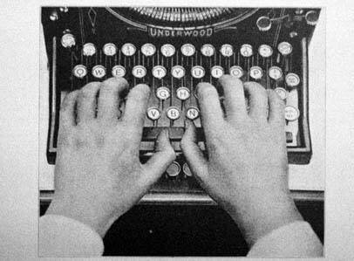
WRITING FOCUS
We will use our study of literature to complement our writing units. We will use our knowledge of craft to accomplish our purposes as authors.

Slide 7
RECAP
AWARENESS OF CRAFT CHOICES
AUTHOR’S PURPOSE
YOU BECOME THE AUTHOR & WRITE WITH PURPOSE USING YOUR AWARENESS OF CRAFT

Slide 8
YEARLONG MOTIF FOCUS
MOTIFS IN AMERICAN LITERATURE
AMERICAN IDENTITY
YOUR IDENTITY

