Slide 1
Symbolism
Symbol: It is when something concrete (something you can touch, see, smell, hear, or taste) represents something abstract (an idea).

Slide 2
Three Level of Symbolism
Level 3: What universal ideas could those details represent?
Level 2: What could these details represent either in history or society?
Level 1: What are some of the concrete/literal details of the symbol?

Slide 3
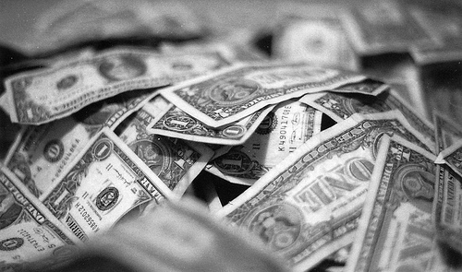
Symbols in everyday life…
Dollar Bill, Dollar Bill, y’all

Slide 4
Working Through Symbolism
Level 3: Universally, money represents the idea of wealth, success, desire.
Level 2: American Society uses the dollar bill as its currency. It acts as a material to trade with, to make purchases with.
Level 1: Concrete/literal: A dollar bill is a piece of green paper.

Slide 5
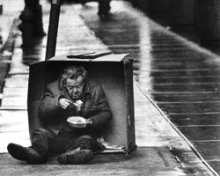
Something to think about…
Remember, symbols can have more than one meaning!
What could money symbolically represent to a self-made millionaire?
What could money symbolically represent to a homeless person?

Slide 6
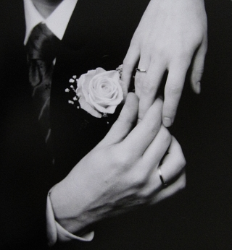
Wedding Ring

Slide 7
Let’s do this one together…
Level 3: What universal ideas could those details represent?
Level 2: What could these details represent either in history or society?
Level 1: What are some of the literal details of the symbol?
What does a wedding ring symbolize to a newly married couple? To a couple that has been married for fifty years?

Slide 8
Symbolic situations in life…
Thumbs up
Coal in your Christmas Stocking
Giving or receiving flowers
What ABSTRACT ideas do these situations/actions represent?

Slide 9
Motif
A MOTIF IS…
When we are talking about a motif within a text:
Any reoccurring object, symbol, phrase, idea, etc. that helps you to understand the theme (message of the novel).

